Slide 1



SMART INDIA HACKATHON 2025
TITLE PAGE
Problem Statement ID- SIH25074
Problem Statement Title- AI-Powered Personal Farming Assistant for Kerala Farmers
Theme- Agriculture, FoodTech & Rural Development
PS Category- Software
Team ID-
Team Name (Registered on portal)

Slide 2
MANTHANX
IDEA TITLE
Limited Access to Localized Farming Knowledge
AI-Powered Local Assistance
Farmers often lack timely, region-specific advice on crops, pests, and weather, leading to uncertainty in decisions.
An intelligent system delivering personalized guidance in the local language with voice and image support.
MANTHANX: Smart AgriAssist
An AI-powered, farmer-friendly platform that provides localized crop guidance, voice-enabled support, real-time alerts, and easy access to government schemes—designed to bridge the digital gap and boost farming efficiency in Kerala and beyond.
Simple & Inclusive Platform
Digital Divide in Rural Communities
Easy-to-use interface with voice commands, real-time alerts, and translations to make technology accessible to all farmers.
Low tech literacy and complex tools make it hard for farmers to benefit from existing digital platforms.
@SIH Idea submission- Template
@SIH Idea submission- Template

Slide 3
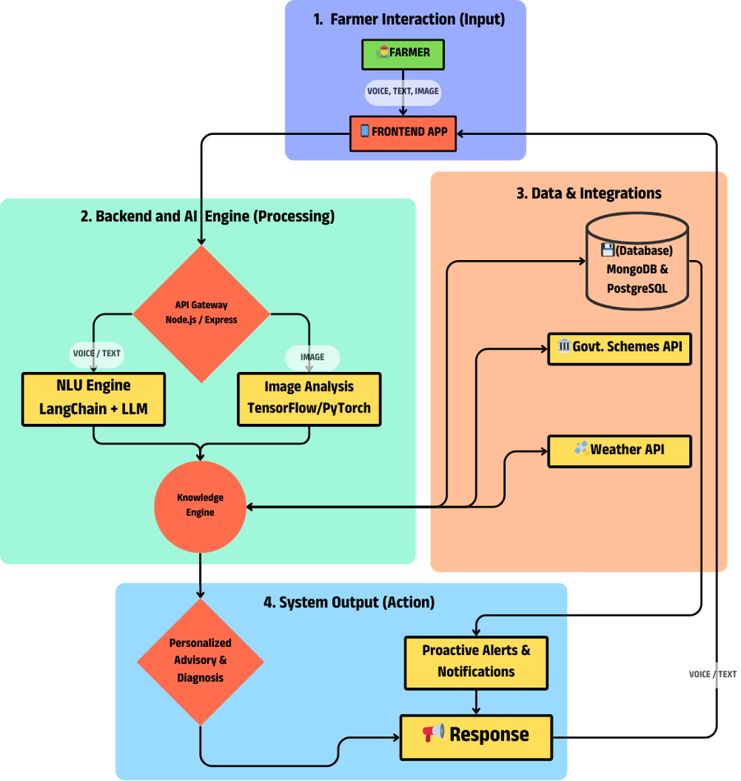




MANTHANX
TECHNICAL APPROACH
FRONTEND
React, Tailwind, Framer Motion, Speech API
BACKEND
AI / ML ENGINE
Node.js, Express, Socket.IO
OpenAI, LangChain, TensorFlow, PyTorch
DATABASE LAYER
DEPLOYMENT
MongoDB, PostgreSQL
Netlify, AWS EC2
INTEGRATION & APIS
Weather, Govt Schemes, Translation
@SIH Idea submission- Template

Slide 4






MANTHANX
FEASIBILITY AND VIABILITY
Challenges and Risk
Adoption may be slowed by low digital literacy, limited internet access, and potential resistance to new technology in rural areas.
Technical Feasibility
Strategies to Overcome
The project leverages reliable AI/ML models, cloud-native infrastructure, and APIs, ensuring scalability and smooth deployment. Local language integration and voice support make it practical for rural users.
Offer a simple voice-based interface, offline-friendly features, and training sessions through local communities to build trust and ease adoption.
@SIH Idea submission- Template

Slide 5










MANTHANX
IMPACT AND BENEFITS
Increased Farmer Profitability
01
Reduces crop loss and increases income through precise, Al-driven advice on pest control, irrigation, and optimal market timing.
02
Data-Driven Governance
Offers real-time, anonymized crop data to help governments improve policies and scheme delivery.
03
High Scalability
Cloud-native design enables quick expansion across languages, regions, and farming needs.
04
Financial Inclusion
Creates a digital "Farm Score" from activity logs, enabling easier access to bank loans and crop insurance for farmers.
05
Supply Chain Integration
Aims to connect farmers directly with buyers ("Farm to Table"), ensuring better prices and reducing post-harvest losses.
@SIH Idea submission- Template

Slide 6
MANTHANX
RESEARCH AND REFERENCES
Technical Paper
AI in Agriculture Studies
"Using Deep Learning for Image-Based Plant Disease Detection." "NusaWrites" (for low-resource language model challenges).
Guided by case studies and research on AI-driven advisory tools in farming, which helped shape the project’s technical approach.
Data Source
Market Report
PlantVillage Dataset (for image recognition). National Data Platform (data.gov.in) & IMD Weather API.
NABARD State Focus Paper - Kerala.
Kerala Economic Review (Agriculture Chapter).
@SIH Idea submission- Template
@SIH Idea submission- Template

